Slide 1
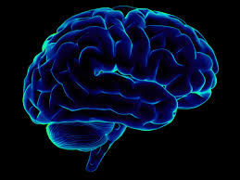

Will Modi hold in for Next Election among Youth?
Ruchi Bhatnagar
Vasanthi Kolachalama

Slide 2
Introduction
2019 is the year where the next assembly elections are going to take place. The four years of Modi government has seen significant steps towards all-round development for the youth across skill development and education. There has also been visible job creation and many promising initiatives in progress in higher education too.
As they say youth is 'new-age power', not 'new-age voter' alone. So we wanted to study the favourability of the Indians towards choosing Narendra Modi as a leader in light of his reforms on youth empowerment.
For ease of the study we divided the reforms under three broad categories:
Skill: The Modi government has evolved a fresh approach to skills and started various reforms like Skill India, Pradhan Mantri Kaushal Vikas Yojana (PMKVY)
Opportunity: The Make In India initiative has opened doors for entrepreneurship, innovation, research and other viable options
Reach: Through Digitalization, Modi has invited digitally empowered society and knowledge economy

Slide 3
Data Sources
1. Twitter data with tweets on the reforms Modi introduced for youth development
www.twitter.com
2. Google trends on related searched terms on interest over time
https://trends.google.com/trends/?geo=US
3. News related articles on Modi and his initiatives for young individuals
https://newsapi.org/

Slide 4
Twitter & News Data Collection and Modelling
1. Data has been collected using from the respective API for the keywords relating to the initiatives taken by Modi government for youth
2. The data was then classified and labeled and the required columns were filtered out
3. “sentimentr" package was used to derive the sentiment of the tweets posted by individuals in India on the reforms
4. Tried to fetch the sentiment of each category and its positivity on the particular reform [ref. slide 6]
5. Then using topic modelling in R, we tried to get the major themes being discussed in the positive and negative type tweets
6. For news data collected, major topics and sub-topics are illustrated in the word cloud [ref. slide 7]

Slide 5
Twitter Data Analysis Results
The Overall sentiment from the tweets collected for multiple terms relating to youth reforms introduced by Modi seems more inclined towards the positive side.
While all three aspects have higher peaks on the positive side, the interesting thing about skill development references is, that it touches the axes on the both the extremes (skill India as an initiative have nearly a balance of mixed opinions on media platforms)

Slide 6
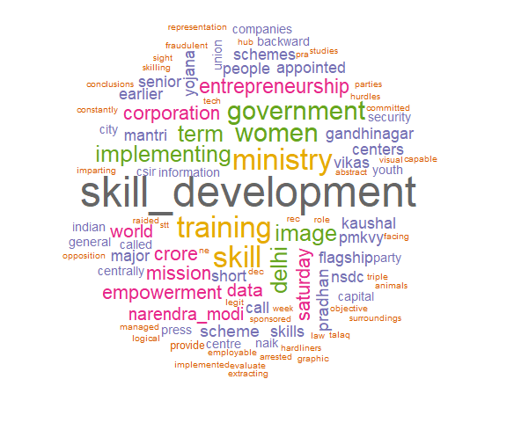
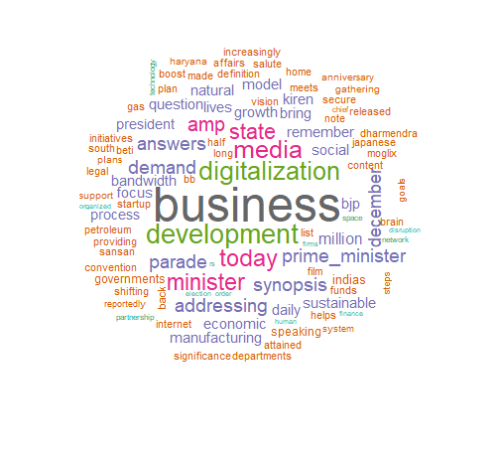
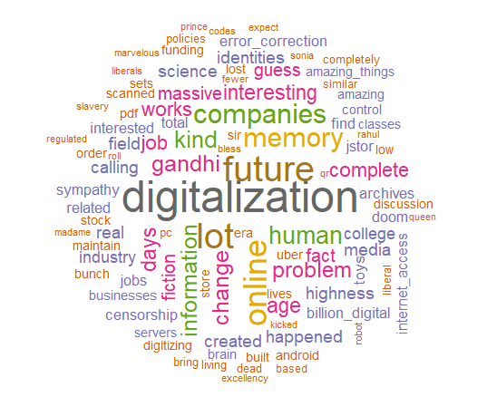
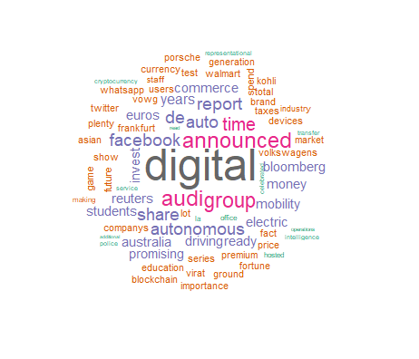
News Data Analysis Results
The news data collected shows four major themes which are Skill development, business, digitalization and digital India.
As Modi has been promoting startup and outreach programs through digital channels, it is noteworthy to see digitalization as part of business and development segment
Interact with PM portal is one such example where people can connect directly with the PM.

Slide 7
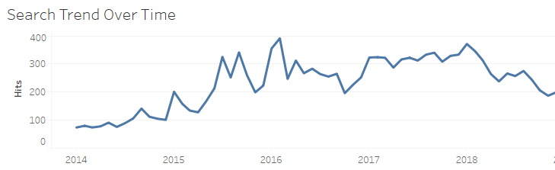
Google Trends Data Collection and Modelling
1. Using google trends API data has been collected to understand the interest over time on the keywords related to the initiatives of Modi
2. Data classification and demographic representation has been done using Tableau
Below is graph showing interest over time data for relevant keywords:

Slide 8
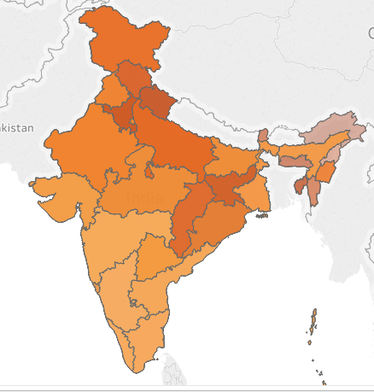

Google Trends Data Analysis Results
Google Trends heat map shows the searches for the relevant keywords on relative volumes for the states.
More interest and influence is observed in the northern part of India.

Slide 9
Conclusion
The results show a good hold of Modi’s popularity w.r.t. his initiatives for youth empowerment
While Twitter data shows more of the positive sentiments with positive applaud (like #farkdikhrahahai, #visionIndia) for Digitalization, Make in India and Skill India initiatives, people have mentioned concerns around Women empowerment, rural unemployment and cybersecurity in the tweets with negative sentiments
It would be a finger-crossing moment to witness the results of 2019 elections as people do acknowledge the positive developments that happened in last 4 years while some polls indicate that Modi has been loosing his popularity over time

Slide 10
Assumptions, Limitation and Further Scope
Assumptions:
Positive sentiment of people on media platform suggests popularity among people and likelihood for a re-vote. Other factors are out-of-scope for this study
All facts and figures are not absolute but relative to each other within the given scope
Limitations:
API limitation on the amount of data we could fetch
The collected opinions are about the reforms introduced for youth empowerment but are collected irrespective of the age of the author
Further work:
As each of the sub-topics show different kind of sentiment score, we can drill down on each of them to understand their contribution to the resultant score
Investigate further on the aspects that needs to be acted upon by the Government

